Slide 1
ESG Investing in Fashion
A case of greenwashing?
Charanjit Singh
Head of ESG Investment Research
December 2019

Slide 2
Key takeaways
  Sustainability of the textile supply chain is a key focus for the fashion industry
  Major apparel brands are claiming that a large share of their cotton supplies are now ‘sustainable’; however, we disagree
  Around 80% of the reported sustainable cotton is the Better Cotton Initiative (BCI) type, whereas the remaining 20% is Organic Cotton
  BCI Cotton’s sustainability performance is no match to Organic Cotton, and we see serious limitations in claiming BCI as sustainable. It is similar to considering supercritical coal as sustainable
  Brands prefer BCI Cotton since it is not priced at a premium, unlike Organic Cotton, which carries a 7-40% premium
  Growth of BCI Cotton has jeopardised the growth of Organic Cotton, which has a huge hidden cost for the society, in our view
  Investors need to take necessary measures to manage the greenwashing in the fashion industry and analyse brands carefully for their sustainable sourcing strategies

Slide 3

Table of content
1
Brands’ response to sourcing sustainable cotton
2
Research objective and methodology
3
Key findings on sustainability indicators
4
Key findings on sustainability indicators

Slide 4

01: Brands’ response to sourcing sustainable cotton

Slide 5
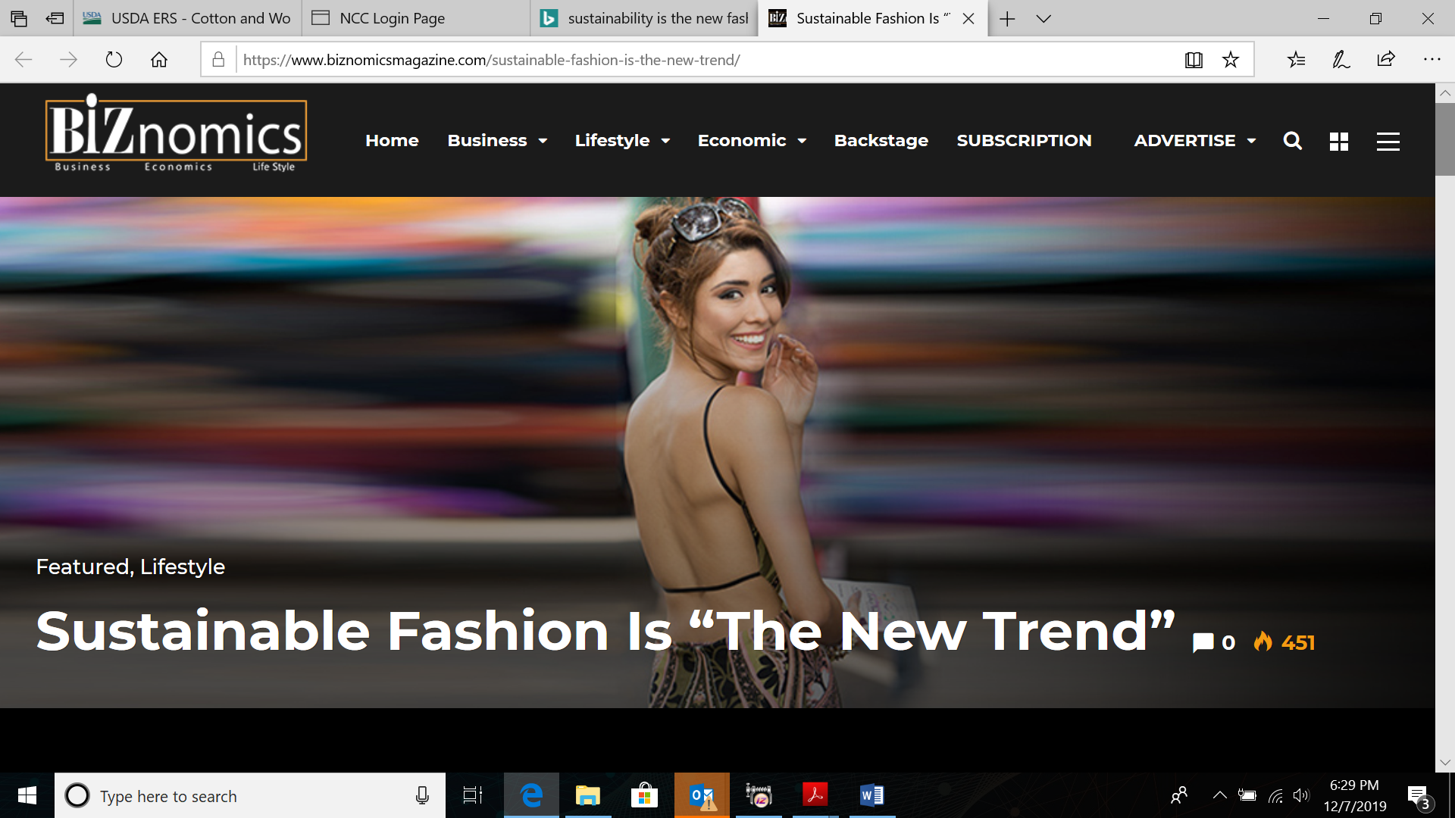
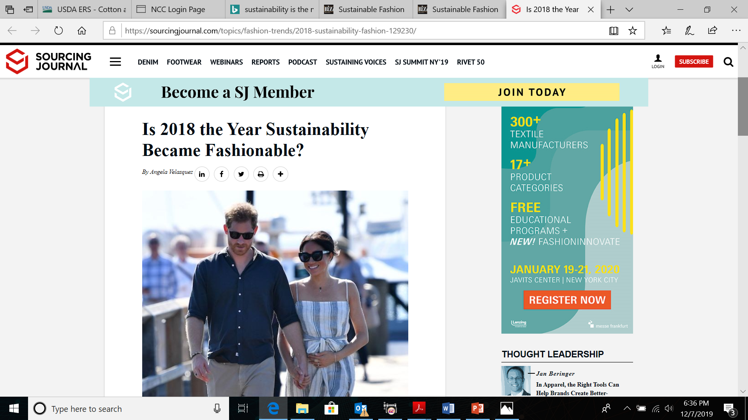
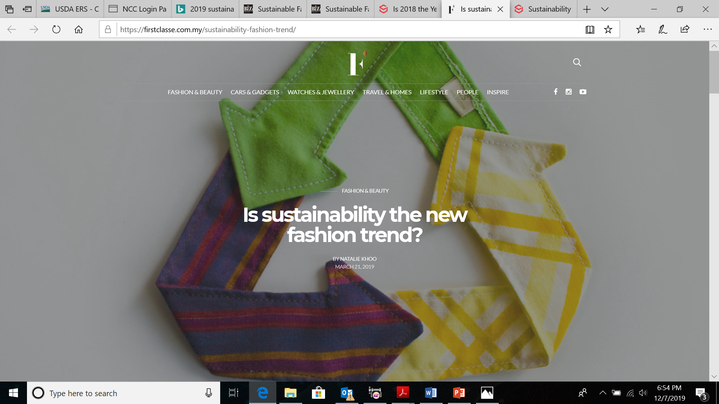
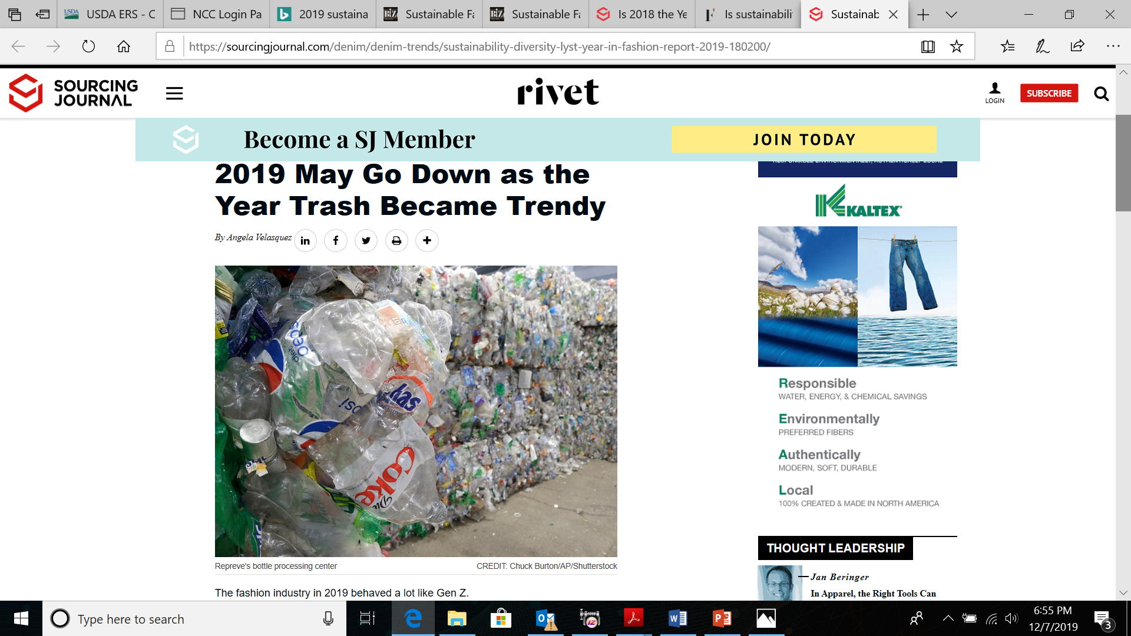
Sustainability in the apparel industry has become a hot topic…
2017/18 - The Ellen MacArthur Foundation Report ‘A New Textiles Economy’ highlighted that:
Clothes release 0.5m tonnes of microfibres into the ocean every year (~ over 50bn plastic bottles)
One garbage truck of textiles is landfilled or burned every second, implying an est. loss of USD 500bn p.a.

Slide 6
…given the environmental challenges with key raw materials
Global fibre production in 2018
Two key raw materials – polyester and cotton – together account for over 75% of total global fibre production
Wool (~1.0%)
Down (~0.3%)
Silk (~0.1%)
Other plant based
(~5.7%)
Polyester is a synthetic petroleum-based fibre and is not biodegradable. It will remain in the ecosystem even as it eventually disintegrates
Polyester (~51.5%)
Cotton
(~24.4%)
~ 107
million mt
MMCFs
(~6.2%)
Other synthetics
(~5.7%)
Cotton is considered to be the world’s dirtiest crop
Polyamide
(~5%)
Source: Preferred Fibre & Materials Market Report 2019, Textile Exchange

Slide 7
Cotton, a key raw material for apparels, is regarded as one of the dirtiest crops due to its resource intensiveness and pollution concerns
As it uses 16-17.5% of the world’s insecticides and 7-10% of all pesticides used globally
About 100m households and 300m people work in the cotton sector globally
Uses 2.4% of the arable land in countries such as India, the US, Pakistan and China
Production of conventional cotton leads to release of c200m tonnes of GHGs per annum
Accounts for 2.6% of the water footprint for all goods and services consumed globally
01
03
05
02
04
Source: Cotton-Pesticide Action Network, Rodale Institute, www.theworldcounts.com, www.bettermeetsreality.com, Fair Trade, Science Direct, Textile Exchange

Slide 8
Brands claim that a large share of their cotton supply is sustainable
Brands are reporting sustainable sourcing of two types, BCI and Organic Cotton
Clearly BCI Cotton is the preferred option, with over 80% share of total sustainable cotton procured
Brands targeting to grow the share of sustainable raw materials
BCI Cotton is the preferred option for brands
Retailer Name | % share of BCI in total procurement | % of certified Organic Cotton in total procurement
H&M | 15% | 80%
Nike | 50% | 8%
Gap Inc | 40%
Adidas | 99% | 1%
M&S
Levi Strauss | 67%
Tchibo
Next UK | 13%
Otto Group
Bestseller | 55% | 7%
Burberry | 68%
Decathalon | 69% | 6%
Kathmandu Holdings | 65% | 22%
IKEA | 80% | 0%
Inditex
Target Corp.
Fast Retailing
Kering
Hermes
VF Corp
L Brands

Slide 9
02: Research objective and methodology

Slide 10
Objective : Examining sustainability credentials
  To analyse the environmental and social performance indicators of BCI and Organic Cotton in South Asia, which accounts for around 60% of world’s cotton production

Slide 11
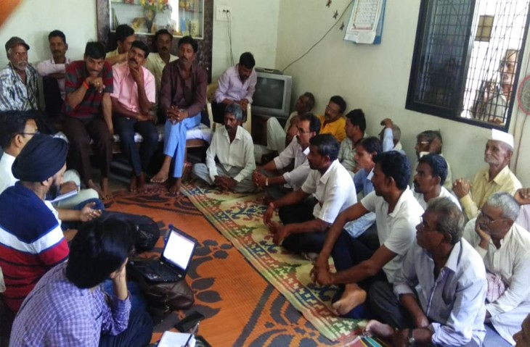
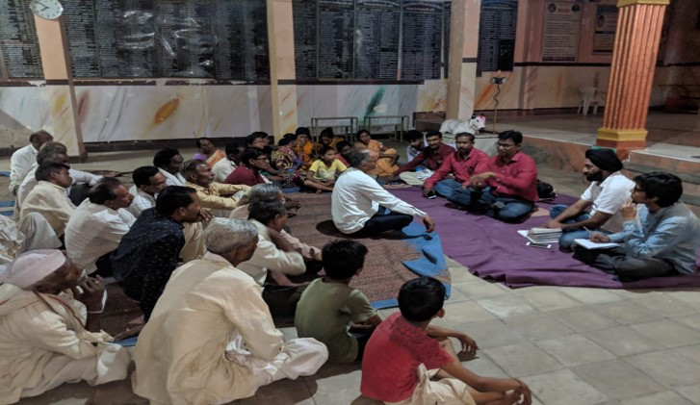
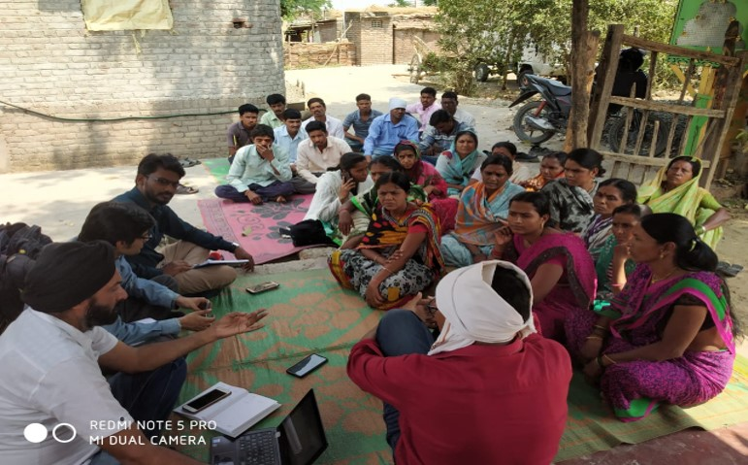
Methodology: Both primary and secondary research
  Visits to cotton fields and focused group discussions with farmers
  Discussions with Foundations and NGOs working with cotton farmers
  Meetings with sector experts
  Extensive secondary research

Slide 12
03: Key findings on sustainability indicators

Slide 13
Understanding BCI
  BCI, an independent organisation, was launched in 2009 following the collaboration of some NGOs. It promotes better standards and practices for cotton farming across 21 countries
  The initiative focuses on building capacity of farmers to gradually improve their E&S indicators
  Apparel brands pay a fee of EUR5-7 per season to each BCI-implementing partner, which does not even translate to 1% of cotton’s market price per kg
  BCI’s average performance data of three countries (India, China and Pakistan) shown in the chart is the result of around a decade long effort. BCI’s reported data has not been thoroughly audited by an independent agency, to the best of our understanding
BCI Farmers Savings vs. Conventional Farmers for 2017 -18 season
BCI Farmers Savings vs. Conventional Farmers for 2017-18 season
Source: Farmer Results 2017-18 Season , BCI.Org

Slide 14
BCI Cotton’s sustainability performance is no match to Organic Cotton
GOLD
Standard on
sustainability
Organic Fair Trade Cotton (OFT)
Comparison of Organic & BCI Cotton on Farming Inputs
Inputs permitted | BCI | Organic
Use of Chemical Fertilisers | √ | X
Use of Chemical Pesticides | √ | X
Use of GMO Seeds | √ | X
Mandatory use of Organic Seeds | X | √
Compulsory, Crop Rotation | X | √
Mandatory Certification & 3rd Party Audit | X | √
Organic Cotton (OC)
BCI & Cotton Connect's REEL Cotton (REEL)
Performance Comparison of Organic & BCI Cotton relative to BT Cotton
Conventional
/ BAU
Performance parameter | BCI | Organic
GHG emissions | n/a | Up to 46% less
Soil acidification | n/a | Up to 70% less
Soil erosion | n/a | Up to 26% less
Water consumption | n/a | Up to 91% less
Energy consumption | n/a | Up to 62% less
BT Cotton (Conventional)
Source: www.colruytgroup.com

Slide 15
Serious limitations in claiming BCI as ‘sustainable’
01
No performance benchmark has been used to classify BCI Cotton as ‘sustainable’.
There are likely to be numerous cases where the E&S performance of a BCI farm at a particular location is worse than that of a conventional farm at locations within the same state, province and country. In such scenarios, how is it justified to consider BCI cotton as ‘sustainable’?
There are no independent third-party audits done to validate the improvement claims and baseline assessment.
02
03
Claiming BCI Cotton as ‘sustainable’ due to its improved performance over conventional cotton, is like :
Considering supercritical coal as sustainable, since it is environmentally better than subcritical coal
Considering it at par with Organic/Fair Trade Organic cotton, despite significantly poor performance on E&S indicators

Slide 16
Independent studies raise serious concerns on environmental claims of BCI Cotton
The research showed that the reduction of water use in the region could not be associated with higher soil salinity. This questions the appropriateness of the BCI criteria regarding the many different regions in which it operates.
The study recommends BCI to initiate impact monitoring in order to legitimise its sustainability claims with actual proof.
According to a 2017 report by the UN’s International Trade Centre, the rapid growth of the BCI programme is ‘largely due to its less stringent requirements’ than other standards (ITC, 2017, p.16).
For the BCI to deliver on its promise to promote the production of genuinely better cotton, it would have to begin by making a commitment to Organic Cotton production, explicitly prohibiting the use of GM crops and establishing a timetable for the complete phase-out of toxic pesticides and fertilisers in global cotton supply chains. In the absence of these changes, it is likely to lead to greenwashing on an industrial scale. Serious reform would be required for it to deliver on its promise; in its current state, it appears unreformable and should be scrapped.
Source: BCI AND THE GREENING OF COTTON: 15 JUNE 2015 , International Land and Water Management – Wageningen University
Source: The false promise of certification, May 2018, The Changing Markets Foundation.
Source: The false promise of certification, May 2018, The Changing Markets Foundation.

Slide 17
Independent study undermines BCI’s claims for improvement on social indicators
  An independent field study conducted on 3,628 households in Madhya Pradesh (India), highlights higher losses for BCI farmers (see figure).
  This is in complete contrast to BCI’s reported data for India, which claims that BCI farmers are around 22% more profitable compared to conventional farmers.
Findings of a social impact assessment in Khargone district, MP (India) based on sample of 3,628 households
Higher losses for BCI farmers (blue columns)
Source: Social and Economic Impact Assessment of Cotton Farming in Madhya Pradesh-SEPTEMBER 2018, AMERICAN INSTITUTES FOR RESEARCH

Slide 18
BCI has jeopardised the growth of Organic Cotton
Despite its poor E&S performance, BCI Cotton is preferred by brands as it has no price premium, unlike Organic Cotton
Growth of BCI has adversely impacted the growth of Organic Cotton, which has huge hidden costs for the society
01
Price premium for Organic Cotton in some key markets
BCI growth has resulted in a low price premium for Organic Cotton in key markets such as India
Country | Country's share in global Organic Cotton production | Price premium for Organic Cotton vs. the conventional cotton
India | 51% | 7%
China | 19% | 15-35%
Turkey | 6.6% | 10%
US | n/a | 40%
Kyrgyzstan | 6.80% | n/a
Tajikistan | 5.40% | n/a
Has diluted the efforts required to develop the Organic Cotton supply chain (seeds, fertilisers, pesticides, etc.)
02
Source: Organic Cotton Market Report 2018, Textile Exchange

Slide 19
04: Suggested action points for investors

Slide 20






Likely actions by investors to drive sustainability in the cotton supply chain
1.Review the standards used to classify BCI Cotton as ‘sustainable’ and carry out a deep dive into the data validation and audit approach
4. Drive brands towards developing efficient market mechanisms for supporting the growth of the Organic Cotton supply chain
2. Drive the brands towards increasing the share of Organic Cotton or Fairtrade Organic Cotton
5. Drive brands to disclose their strategies on sourcing sustainable polyester and nylon
Role of
Investors
3. Analyse the profitability of brands for their Organic Cotton offerings to guide them for premium sharing with farmers
6. Analyse the brands for their sustainable sourcing strategies, in order to identify the winners and losers for investment decision making

Slide 21
Acuity Knowledge Partners
Elixir Chancery,
Bangalore, Karnataka
560 025, India
CHARANJIT SINGH
Head of ESG Investment Research
charanjit.singh@acuitykp.com
Mobile +91 990 247 8900

